Slide 1
LAN Technologies

Slide 2
Ethernet
It is associated with the cables and give the specification of the cable.
Ethernet describes a technology for cabled data networks that connect software and/or hardware with each other.
It is also sometimes referred to as LAN technology.
It enables data exchanges between end devices.
These could be computers, printers, servers, routers, or others.
When combined into a local network, these devices establish connections via the Ethernet protocol and can exchange data packages with one another.
The current and most widely distributed protocol is IEEE 802.3.

Slide 3
Thick Ethernet
Thick Ethernet was the first commercially available form of cabling supported by Ethernet.
It is technically known as 10-BASE-5.
Here, 10 is the maximum throughput, i.e. 10 Mbps, BASE denoted use of baseband transmission, and 5 refers to the maximum segment length of 500 metres (1,600 ft).
This type of cabling allows 100 stations to be connected to it by vampire taps.
The stations share a single collision domain.

Slide 4
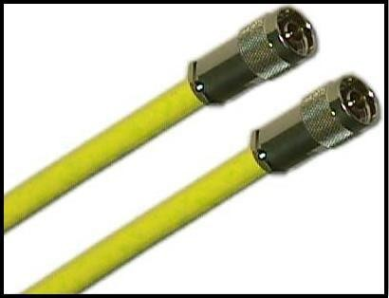
contd...

Slide 5
Structure of Cable
The coaxial cable of thick Ethernet is 0.5 inches in diameter and usually has a yellow outer PVC coating.
The coaxial cable has a stiff inner copper conductor for transmitting signals.
This is covered by an inner insulation.
This insulator is encased by a closely woven braided metal outer conductor that acts as a shield against noise.
The outer conductor is enclosed by the yellow PVC outer coating.

Slide 6
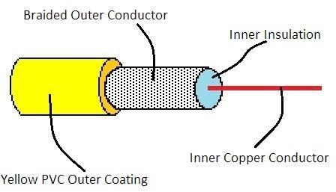
contd...

Slide 7
Network Design
The thick Ethernet is deployed using bus topology.
The 10-Base-5 co-axial cable forms the shared bus. Up to 100 stations may be connected to it by vampire taps through AUI (attachment unit interface) cables.

Slide 8
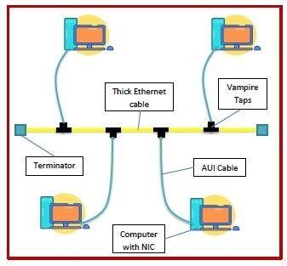
contd...

Slide 9
Thin Ethernet
Thin Ethernet, popularly known as thinnet, is among the family of Ethernet standards that uses thinner coaxial cable as a
transmission media. It is technically known as 10-BASE-2.
Here, 10 is the maximum throughput, i.e. 10 Mbps, BASE denoted use of baseband transmission, and 2 refers to the maximum segment length of about 200 metres (precisely 185 metres).
This type of cabling allows a maximum of 30 stations to be connected to it by BNC connectors with 50 centimetres minimum gap between subsequent stations.

Slide 10
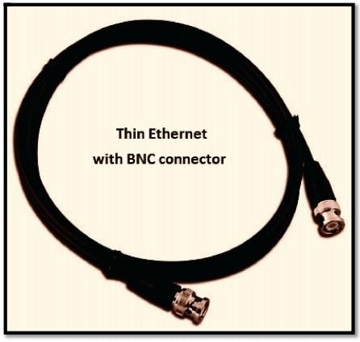
contd...

Slide 11
Features of Cable and Network
The salient features of 10-BASE-2 Ethernet cabling are −
10-BASE-2 use RG-58 A/U coaxial cable. It is thinner, more flexible, more economic and easier to install than the coaxial cable used in thick Ethernet.
The cable has 10 Mbps transmission speed.
The maximum segment length is 185 m and the minimum gap between stations is 50 cm.
The maximum number of stations that can be connected is restricted to 30.
Thinnet uses Manchester coding.
A low-to-high transition in the middle of the bit period is encoded as binary 0 while a high-to-low transition in the middle of the bit period is encoded as binary 1.
It uses BNC T-connector for connecting with the stations network interface card (NIC) and also for joining cables.
The thin coaxial cable is terminated by a 50 ohm resistor at both the ends.

Slide 12
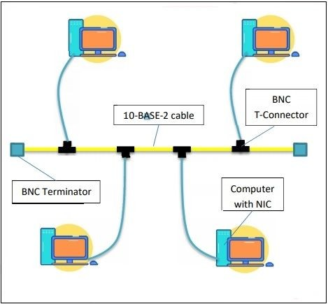
Thin Ethernet network is shown in the following diagram

Slide 13
Ethernet Throughput
Throughput of a system refers to the rate of processing of a task there by generating results.
Ethernet is a set of technologies primarily used in LANs, whose primary data units are frames.
The throughput of Ethernet is measured by the rate of successful delivery of frames over a communication channel.

Slide 14
Ethernet IEEE 802.3
Ethernet is a set of technologies and protocols that are used primarily in LANs.
It was first standardized in 1980s by IEEE 802.3 standard.
IEEE 802.3 defines the physical layer and the medium access control (MAC) sub-layer of the data link layer for wired Ethernet networks.

Slide 15
IEEE 802.3 Popular Versions
There are a number of versions of IEEE 802.3 protocol. The most popular ones are -
IEEE 802.3: This was the original standard given for 10BASE-5. It used a thick single coaxial cable into which a connection can be tapped by drilling into the cable to the core. Here, 10 is the maximum throughput, i.e. 10 Mbps, BASE denoted use of baseband transmission, and 5 refers to the maximum segment length of 500m.
IEEE 802.3a: This gave the standard for thin coax (10BASE-2), which is a thinner variety where the segments of coaxial cables are connected by BNC connectors. The 2 refers to the maximum segment length of about 200m (185m to be precise).
IEEE 802.3i: This gave the standard for twisted pair (10BASE-T) that uses unshielded twisted pair (UTP) copper wires as physical layer medium. The further variations were given by IEEE 802.3u for 100BASE-TX, 100BASE-T4 and 100BASE-FX.
IEEE 802.3i: This gave the standard for Ethernet over Fiber (10BASE-F) that uses fiber optic cables as medium of transmission.

Slide 16
Types of Ethernet
Classic Ethernet
Switch Ethernet
Fast Ethernet
Gigabit Ethernet

Slide 17
Classic Ethernet
Classic Ethernet is the original form of Ethernet used primarily in LANs.
It provides data rates between 3 to 10 Mbps.
It operates both in the physical layer and in the MAC sublayer of the OSI model.
In the physical layer, the features of the cables and networks are considered.
In MAC sublayer, the frame formats for the Ethernet data frame are laid down.
Classic Ethernet was first standardized in 1980s as IEEE 802.3 standard.

Slide 18
The common varieties of classic Ethernet are -
Thick coax (10BASE-5)
Thin coax (10BASE-2)
Twisted pair (10BASE-T)
Ethernet over Fiber (10BASE-F)

Slide 19
Frame Format of Classic Ethernet
Classic Ethernet frames can be either of Ethernet (DIX) or of IEEE 802.3 standard. The frames of the two standards are very similar except for one field. The main fields of a frame of classic Ethernet are −
Preamble − It is the starting field that provides alert and timing pulse for transmission. In case of Ethernet (DIX) it is an 8
byte field and in case of IEEE 802.3 it is of 7 bytes.
Start of Frame Delimiter (SOF) − It is a 1 byte field in an IEEE 802.3 frame that contains an alternating pattern of ones and zeros ending with two ones.
Destination Address − It is a 6 byte field containing physical address of destination stations.

Slide 20
contd...
Source Address − It is a 6 byte field containing the physical address of the sending station.
Type/Length − This is a 2 byte field. In case of Ethernet (DIX), the field is type that instructs the receiver which process to give the frame to. In case of IEEE 802.3, the field is length that stores the number of bytes in the data field.
Data − This is a variable sized field carries the data from the upper layers. The maximum size of data field is 1500 bytes.
Padding − This is added to the data to bring its length to the minimum requirement of 46 bytes.
CRC − CRC stands for cyclic redundancy check. It contains the error detection information.

Slide 21
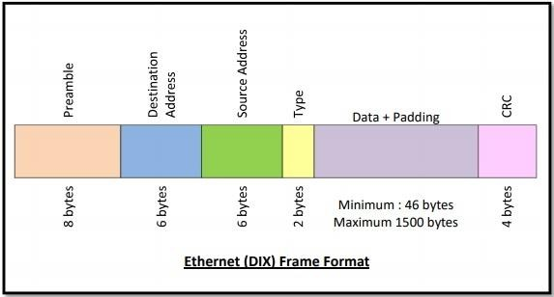
contd...

Slide 22
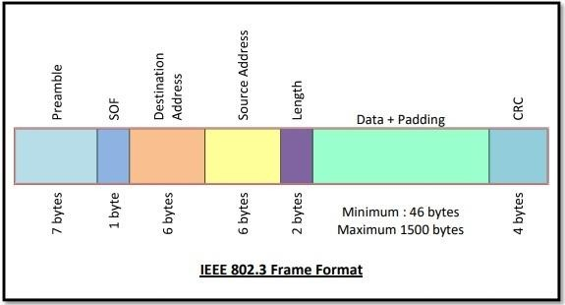
contd...

